Slide 1



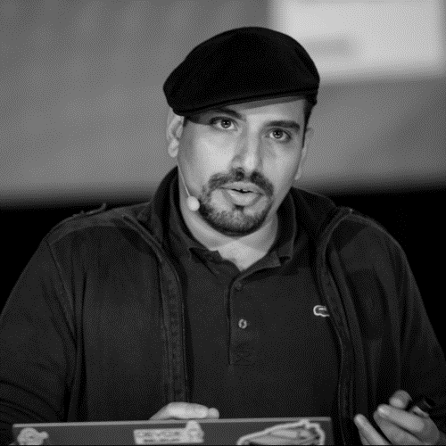
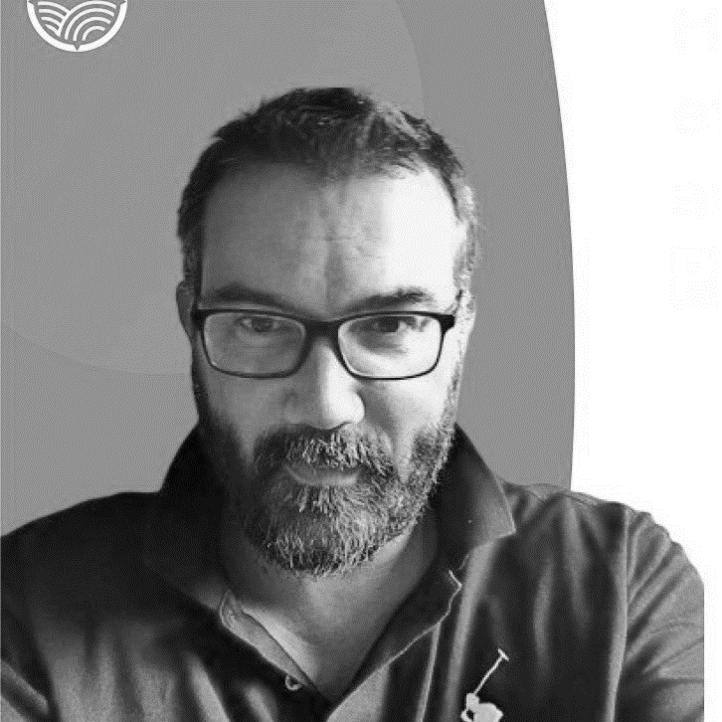
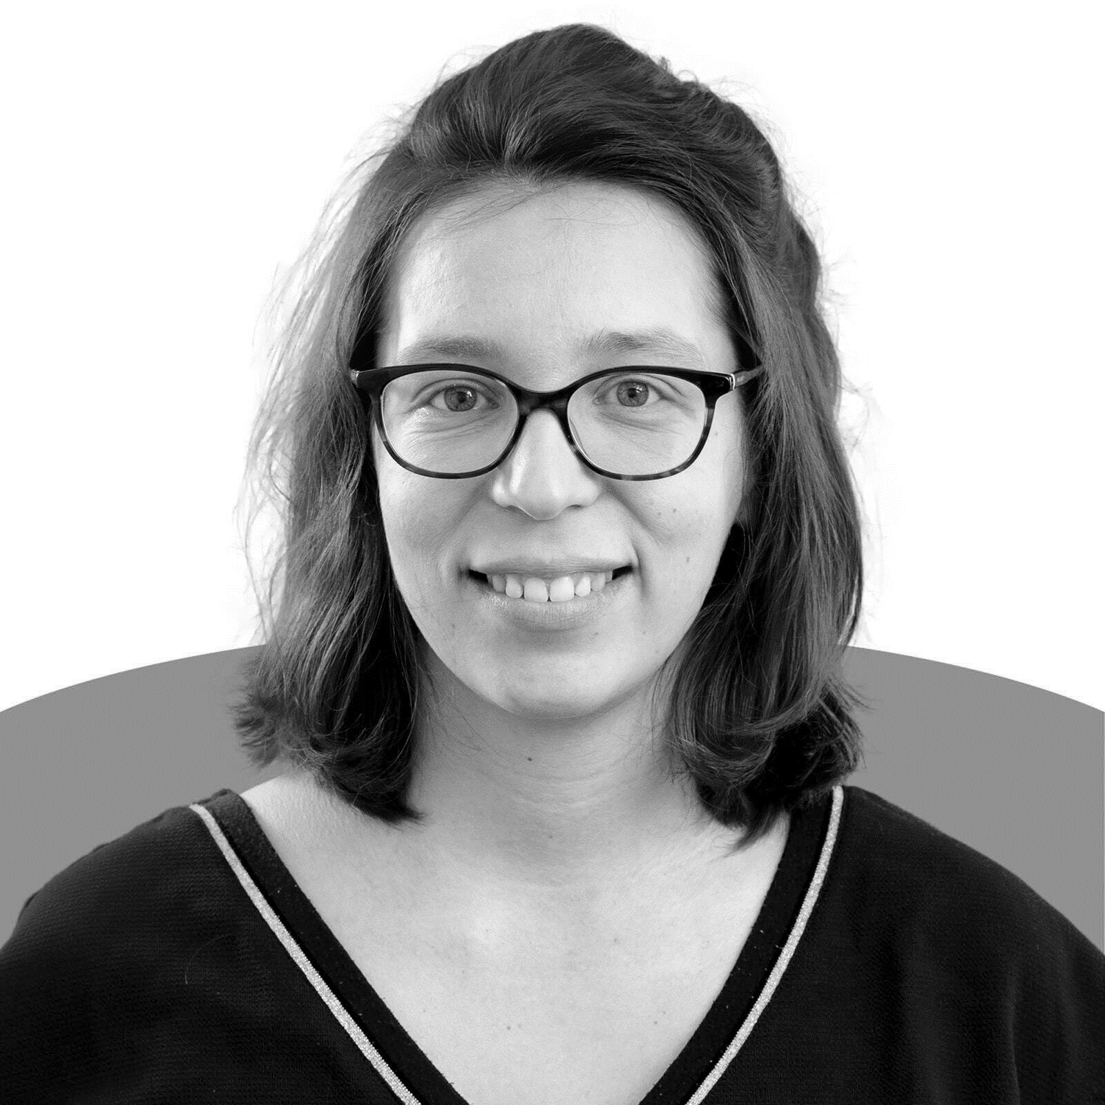
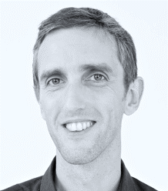
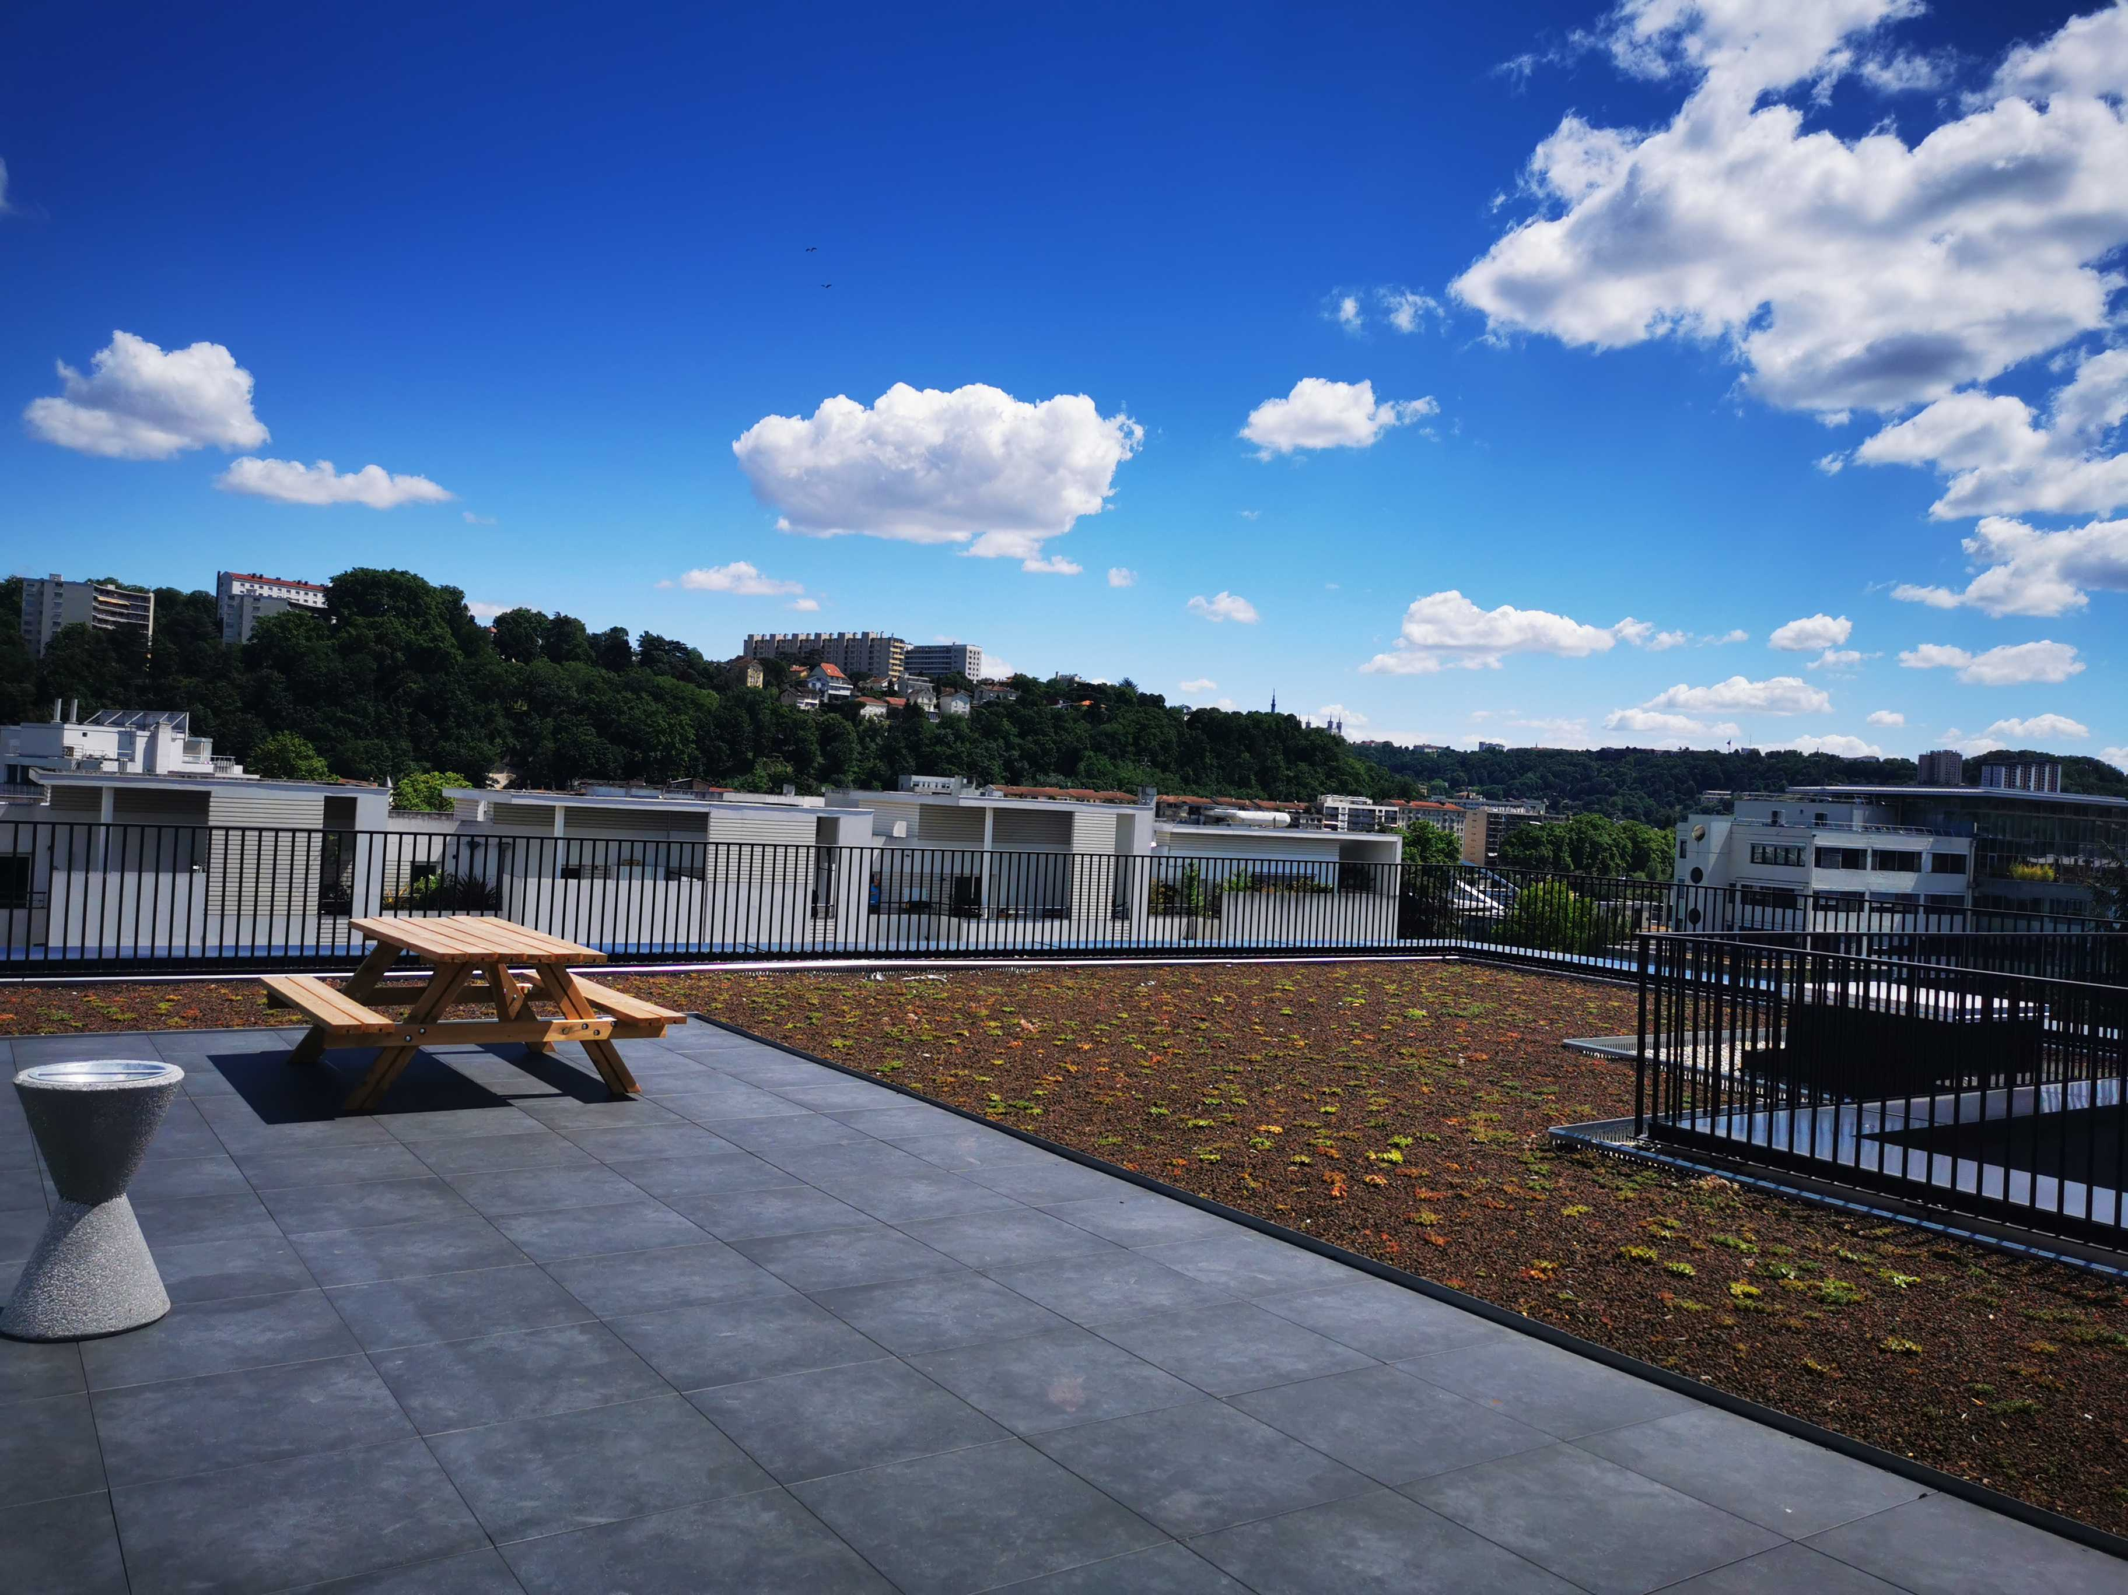
Context maps on the roof
Tuesday Sept 13th 2022
19h00
at
#DDDFR
( Lyon )
Julien Topçu (shodo)
Train reservation
Caroline Desplanques
Thomas PIERRAIN (agicap)
Cashflow monitoring
3 domains presented in 20’ with Context Maps on the rooftop of a building
Maguy Ribeiro (Michelin) Jeremie Grodziski (Defsquare )
MIchelin

